Slide 1
Ignatian Leadership & Discernment
The Inner Life of the Leader
Resources from Ignatian Spirituality
Leadership & Discernment

Slide 2
Questions to Explore
What is the current context in which we lead?
What relevance does the inner life of the leader have to do with leadership?
What are some of the key principles of Ignatian spirituality for leadership?
What is the role of discernment in leadership?

Slide 3
Context
Reading the Signs of the Times

Slide 5
The inner life of the leader
Leading from the heart…

Slide 7
The Resources from Ignatian spirituality for leadership
Drinking from Our Own Well

Slide 9
Discernment & Leadership
Discovering Our Way Together

Slide 10
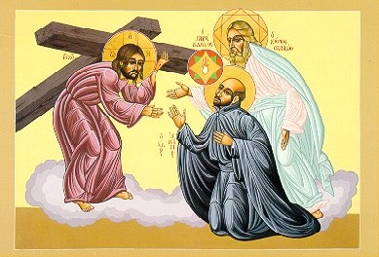

Slide 11
Questions and discussion
Engagement

Slide 12
Thank you for participating!

Slide 13
Information
Rev. David McCallum, S.J., Ed.D
VP for Mission Integration and Development
Le Moyne College
Syracuse, NY 13214
USA
davidmccallumsj@gmail.com
516-242-2968

