Slide 1
Apostolic Planning
A General Process

Slide 2
Fr General, Apostolic Institutions at the Service of Mission, 2014/01
“What I consider most important is that each Conference, Province and Region, initiate or continue a process of discerning how or to what extent its institutions are related to its Apostolic Plan, a plan that identifies the goals, priorities and resources for service that a Province or Region contributes to the Missio Dei.”

Slide 3

???

Slide 4
That evening, after sunset, they brought to him all who were sick and those who were possessed by devils. The whole town came crowding round the door, and he cured many who were sick with diseases of one kind or another; he also drove out many devils, but he would not allow them to speak, because they knew who he was.
In the morning, long before dawn, he got up and left the house and went off to a lonely place and prayed there. Simon and his companions set out in search of him, and when they found him they said, 'Everybody is looking for you.' He answered, 'Let us go elsewhere, to the neighbouring country towns, so that I can proclaim the message there too. Indeed, it was for this purpose that I came.' And he went all through Galilee, preaching in their synagogues and driving out devils.
Mark 1:32-39

Slide 5
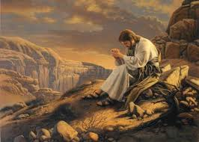

Slide 6
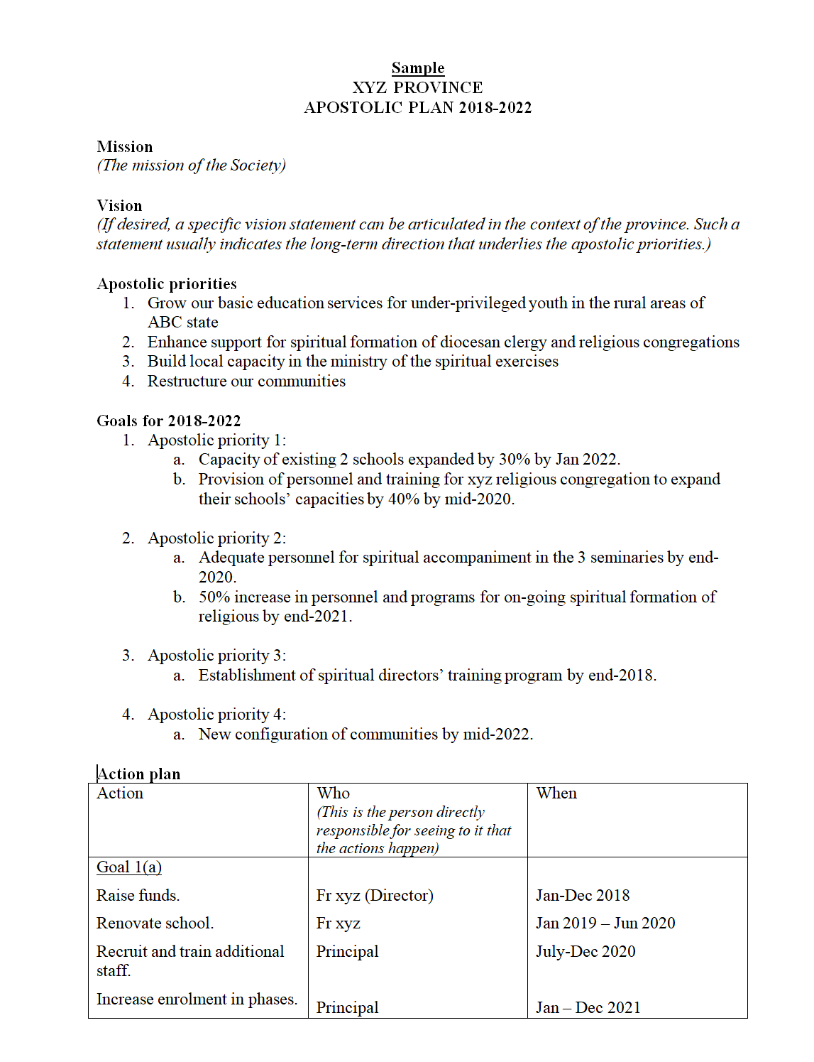

Slide 7
When to do apostolic planning?
    When there have been significant changes in the external and internal context of the organization.
      Importance of observation and reflection
    At least once every 5 years
      But depends on the type of organization, stage of growth and external context

Slide 8
When NOT to do apostolic planning
When there is a crisis
  Country in political crisis or recovering from recent natural disaster
  Crisis in province or institution; eg. Unexpected major changes, significant conflict, low morale, insecurity, etc.
  Build stability first
    Similar to rules for discernment: don’t make major decisions in desolation
When the leader or leadership team needs to establish credibility
  E.g. Past plans not implemented; members are disillusioned with planning
  New leader
  Build credibility first
When most people are new in the organization or unfamiliar with the way of proceeding or unfamiliar with each other
  Eg. New organization or recent turnover of many personnel
  Focus on formation and community-building first
  Conditions for discernment: Interior freedom; Unity of minds and hearts

Slide 9
Preparation
Right time for apostolic planning? If yes:
Decide on process, timeline, resources
Form a planning team to organize the whole process
  Ensure that those with assigned roles will have available time to focus on the planning process
Communicate about it and clarify expectations
  Reason for the apostolic planning
  Process, timeline, activities
  Participation, roles, responsibilities
  Emphasis on spiritual discernment in common
    Give help to those who are not familiar with this

Slide 10
A General Process for
Apostolic Planning

Slide 11
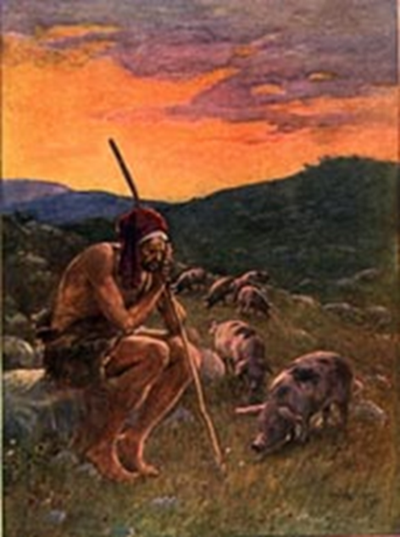
1. Examen and Conversion
Apostolic planning begins with examen and conversion
  We ask for the grace to see ourselves as we really are
  Be attentive to the present realities
  In what ways are we being faithful? In what ways are we lacking in fidelity to our life and mission?
  We ask for the grace of inner freedom, insight, and genuine conversion; to be filled with the love of God; to seek healing

Slide 12
1. Examen and Conversion
Some ways to do this:
  Province:
    Annual Retreat; Province Assembly
  Communities and institutions:
    Organize a series of special days of recollection; Retreat
  Individual:
    Guided prayer
  Inclusive - Jesuits, lay collaborators, major partners
  Prayerful and spiritual reflection
  Adequate time (eg. Prayer and reflection over 1-3 months)
  Resources for examen: Documents from GCs, Constitution and Complementary Norms, Letters from Fr Gen, etc

Slide 13

2. Gratitude
Before we plan for the future, we need to appreciate the past
  Recall the history (or recent history) of the province or institution
  What were the milestones?
  What were the significant times of consolations and desolations? What were the major turning points?
  How has God been present? What are we grateful for?
Appreciating the past helps us to:
  Renew our confidence in God’s fidelity
  Regain a sense of our roots
  Let go and be more open to moving forward

Slide 14
2. Gratitude
Some ways to do this:
  Can be combined with Step 1
  Alternatively, make use of:
    Community meetings
    Institutional gatherings
  Organize a day of recollection
  Resources: Materials on history of the province or institution, photo gallery, stories from senior members, personal sharing by all members
  Spiritual conversation

Slide 15

3. Understanding the Mission
The compass for apostolic planning is the mission of the organization
  Firstly, the mission of Christ: What is it? What is it not?
  Secondly, what is the essence of our type of organization (i.e. a religious congregation, a Catholic school, etc)?
  Thirdly, what is the particular mission and charism of the Society of Jesus?
  In our specific context, what visible signs would indicate that this mission is being well-lived?
Without the compass, there may be an imbalance of influence from present routines, past achievements, pressing requests, pet projects or popular trends.

Slide 16
3. Understanding the Mission
Some ways to do this:
  Resources: Institutional documents, recent GCs, letters from Fr General
  Individual reflection + communal conversation, Days of recollection
  Can be combined with Steps 1-2.
  Deepen the communal understanding
  Be open to new personal insights
  Challenge one another

Slide 17
On Discernment in Common (2017/11)
“The positive tension between discernment in common and apostolic planning requires, according to the Ignatian vision, a spiritual examen of what we have experienced, so that we continually grow in fidelity to the will of God. Therefore, a systematic evaluation of our apostolates is not sufficient. We must supplement that systematic evaluation with the spiritual perspective of the examen, a practice by which Ignatius invites us to recognize the action of God in history, to be grateful for his gifts, to beg pardon for our failure to measure up, and to ask for the grace to be ever better collaborators in God’s work in the world.”

Slide 18

4. Research
Apostolic planning must be based on the reality of the external and internal context
External context:
  What is happening in society? What is happening in the Church?
  What are the needs which are calling out to us?
Internal context:
  What is the current situation of the province or institution?
  What are our present lights and shadows?

Slide 19
4. Research
Some ways to do this:
  Formulate the questions
  Assign personnel to carry out research
  Sources of information:
    Relevant reports and analyses
    Wide consultation:
      Who: Direct experience of those in ministry (Jesuits and collaborators); Those being served by the organization; Partners; Church organizations; NGOs; People around the community
      How: Field visits, Interviews, Focus groups, Meetings, Questionnaires, Casual conversations
  Time: 2-3 months

Slide 20
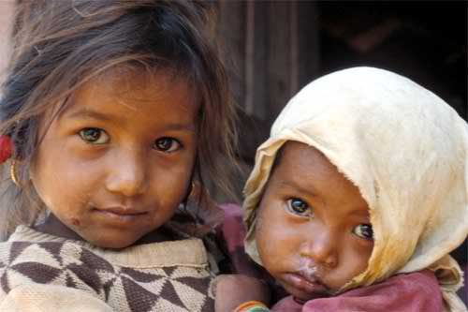

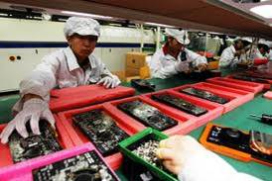

Formulate the questions
External context: Focus on the various groups of people
Eg. Youth, the poor, families, the laity, people of other faiths, etc
  What is their current situation and how is it changing? What trends are affecting them?
  What improvements have they experienced? What challenges do they face? What are their greatest needs?
  How is the holistic dignity of the human person being promoted or violated in our current society?

Slide 21

Formulate the questions
External context: Take a systemic view
  What other organizations are doing something relevant to these needs?
  What trends do we observe about them?
  Where are the gaps?
  What are the opportunities for collaboration and networking?
  How can we contribute or receive support beyond our province?

Slide 22
Formulate the questions
Internal context:
  With reference to our mission (the compass), in what ways have we been fruitful? In what ways have we not been fruitful?
  Strengths: Presently, what are the most significant internal factors that enable us to be fruitful?
  Weaknesses: Presently, what are the most significant internal factors that limit our fruitfulness?

Slide 23
4. Research
A good consultation process will already begin to facilitate insight, conversion, and discernment.

Slide 24
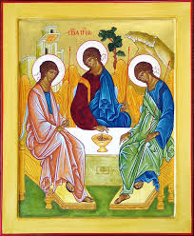
5. Evaluation
Evaluation of the research data is a key step of the discernment. It involves listening to the information with openness, pastoral sensitivity, intelligent analysis, depth, love, and spiritual attentiveness; and building solidarity
  Collate the information gathered about the external and internal context
  Reflect upon it personally and in groups
  Ask further questions and go deeper
  Viewpoint of the Trinity looking upon the world
  Attentiveness to the data as well as our interior movements
  Listening to each other
  Conclusion: Note the significant points about the external and internal contexts

Slide 25

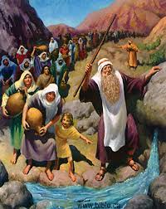
A pilgrim journey
The journey is more important than just producing the apostolic planning document. It is in how we travel together that the vision becomes a reality.
How we treat each other. Divine, communal relationship:
Manifestation of the Kingdom of God
Diversity and conflict are not merely inconvenient hindrances. They are precisely the place of mission, of reconciliation, of transformation towards the KOG.
“The KOG is among you”

Slide 26
5. Evaluation
Some ways to do this:
  Consolidate all research findings into one report about external context and one report about internal context
  Ensure distribution of reports to all those involved in the common discernment. Ensure adequate time for reading and personal reflection
  Gather for a communal dialogue
    Spiritual conversation

Slide 27
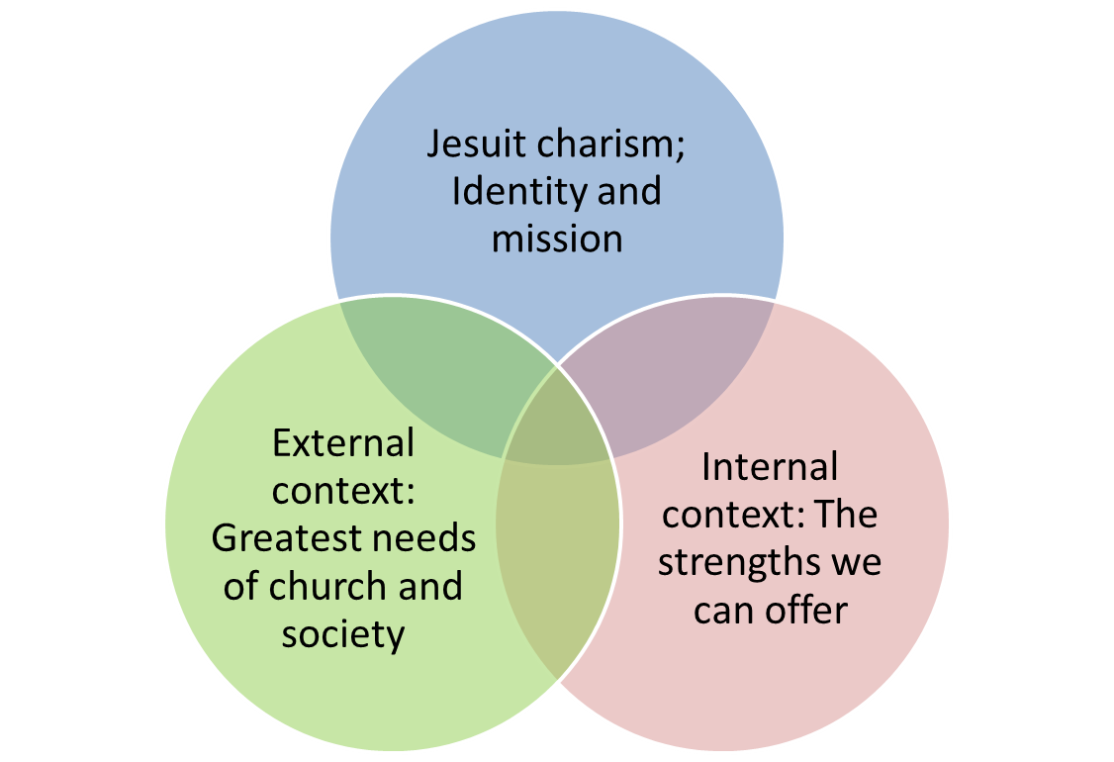
6. Decision on apostolic priorities
Apostolic priorities lie at the intersection of an organization’s enduring mission and the current realities of the external and internal contexts
  The Call of the King for a particular organization in a specific time and place within history
  Time horizon: 5-10 years
  See also relevant guidelines: Constitutions § 622, Complementary Norms 259, etc
  Universal and Conference preferences

Slide 28
Apostolic Priorities
Examples:
  Grow our basic education services for under-privileged youth in the rural areas of ABC state
  Enhance our collaboration in spiritual formation for diocesan clergy and religious congregations
  Initiate peace-building process in the XYZ region
  Expand our ministry of spiritual exercises for urban young adults in xxx city
  Promote care for creation in our schools and parishes
Need not exclude ad intra priorities
  Eg. Strengthen community life

Slide 29
Apostolic Priorities
Common mistakes:
  Having too many priorities
  Not letting go of past priorities that are no longer relevant
  Identifying activities rather than priorities
    Activities are specific programs or actions. Eg. Build a school, start a spirituality program, expand the university faculty
    Priorities indicate the main direction of apostolic focus
  Stating the priorities too vaguely
    Eg. of vaguely-stated priority: “Education”
    Eg. of clearly-stated priority: “Grow our basic education services for under-privileged youth in the rural areas of ABC state”
    Assessing how clearly your apostolic priority is stated:
      Does it indicate who, what, where?
      Does it help you make decisions on allocation of personnel and resources?
      Does it help you to identify specific partners?
      Does it indicate what changes are needed in the organization?

Slide 30
6. Decision on apostolic priorities
Some ways to do this
  Spiritual discernment in common
  Gathering over several days or in retreat
  Only after Steps 1-5 have been carried out well, and there is general satisfaction and consolation in the process so far
  Iterative process of proposing options, deliberation, prayer, tentative decision, etc
  Seek spiritual confirmation

Slide 31

7. Specific goals
Without specific goals, apostolic priorities remain a distant dream
  Specific goals refer to concrete things to achieve in order to actualize the apostolic priority
  Usually more than one goal for each priority
  Each goal is time-based

Slide 32
Specific goals
Example: Apostolic priority #1 (Grow our basic education services for under-privileged youth in the rural areas of ABC state)
  Goal 1: Expand capacity of existing 2 schools by 30% by 2019.
  Goal 2: Provide personnel and training for xxx religious congregation to expand their schools’ capacity by 40% by 2020.
  Goal 3: Start new Jesuit school in xyz village by 2022.
  Goal 4: Evaluate and update curriculum in all schools by 2025.

Slide 33
Specific goals
  Common mistakes:
    Unrealistic goals
    Lack of creativity in strategies
    Lack of exploring opportunities for collaboration
    Too vague (Specify who, what, where, when, how)
    No real impact on the priority

Slide 34
8. Action plans
Action plans enable coordination of efforts towards the goals
  Process of action planning helps to fine-tune the goals
  Confirmation of discernment
  Not too specific, not too vague

Slide 35
Do an action plan for each goal
List the main actions after considering the following questions:
  What are the steps needed to reach this goal? How will we get the resources? What changes are needed? What can be done about the anticipated difficulties?
Who will be in charge of doing this?
When will it be done?
Goal #1
Main actions | Who | When
1.
2.
3.

Slide 36
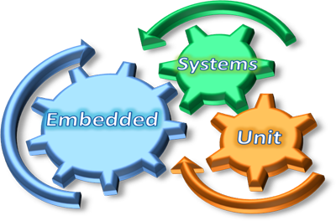
What changes are needed?
New priorities often do not fit with existing structures. Hence need a systemic approach: What adjustments are needed in the current structures, policies, personnel, resources, activities?
Availability …. inner freedom …. practical wisdom

Slide 37
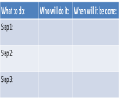
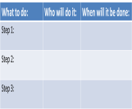
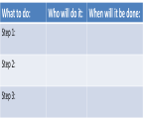
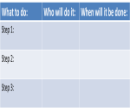
Action plans
Goal
PRIORITY 1
Goal
Mission, context
PRIORITY 2
Goal
Goal
PRIORITY 3
Goal
Goal

Slide 38

9. Monitoring and evaluation system
Monitoring and evaluation helps to keep us on the right track
  Agree on how and when this will be done
  Review of progress vis-à-vis action plans
  More importantly, spiritual examen

Slide 39
Monitoring and Evaluation
Who will animate and monitor implementation?
  Appoint an “Apostolic Plan Coordinator” (only for initial period of implementation)
  Or make it a responsibility of an existing committee
How is monitoring done?
  Regular contact with persons responsible for action
  Progress reports
  Meetings (more frequently in the beginning)
How is evaluation done?
  When? How often? By whom?
  Discernment of spirits: What have been our consolations and desolations? Are we moving in the direction which we have discerned and resolved to take? Are any changes needed?
  Make revisions to the action plan where necessary

Slide 40
Monitoring and Evaluation
Support those who face more difficult changes
  Listening
  Assistance
  Resources
Be flexible
  The apostolic plan is a general guide
  Can’t predict the future
  Fidelity to the main directions that emerged from the discernment
  Appropriate response and adaptation to unfolding events

Slide 41

10. Communication
Communication of the apostolic plan facilitates implementation and partnerships
  Ensure all members and partners know and understand the apostolic plan
  Have channels for feedback and dialogue
  On-going point of reference for decision-making

Slide 42
Step 10: Communication
Some ways to do this:
  Letters from Provincial
  Assemblies
  Meetings of communities and institutions
  Newsletter, internet

Slide 43
Basic steps of apostolic planning
Examen and conversion
Gratitude
Understanding the mission
Research
Evaluation
Decision on apostolic priorities
Specific goals
Action plans
Monitoring and evaluation system
Communication

Slide 44
Sample timeline
1st-3rd months
  1. Examen and conversion
  2. Gratitude
  3. Understanding the mission
  Activities:
    Retreats, Days of recollection, Personal prayer, Community meetings, Staff meetings, etc.
    Provide questions for guided reflection and conversation (as per previous slides)

Slide 45
Sample timeline
4th – 6th months
  4. Research on external and internal context
  Activities:
    Assign researchers
    Researchers to carry out meetings, interviews, review of statistics and reports, focus groups, casual conversations, questionnaires
    Consolidate all the information gathered into one report each for external and internal context
    Disseminate the reports

Slide 46
Sample timeline
7th-9th months
  5. Evaluation
  6. Decision on priorities
  Activities:
    Personal prayer and reflection on the reports, and review of all previous steps
    Reflection on the reports in small groups (community meeting, institutional meetings)
    Preparation for province assembly or a planning weekend with lay collaborators
    Province assembly / Planning weekend (Agenda: Dialogue about the external and internal context; Discernment; Decision on the apostolic priorities)
    Organize a follow-up session if more time is needed for the discernment
    Alternatively, have a series of days of recollection over 2-3 months

Slide 47
Sample timeline
10th month
  7. Specific goals
  8. Action plans
  9. Monitoring and evaluation system
  10. Communication
  Activities:
    Gathering of relevant personnel to work on steps 7-9
    Drafting of final apostolic plan
    Communication, feedback, fine-tuning
    Begin implementation

Slide 48
Managing change
Apostolic planning, province/institutional restructuring:
  Uncertainty, fear, anxiety
  Resistance to change
Importance of leaders’ role
  Listening, understanding people’s feelings and potential reactions
  Being present
  Adaptability
  Appreciation of people’s efforts
  Clarity of information and expectations

Slide 49
A pilgrim journey
The journey is more important than just producing the apostolic planning document. It is in how we travel together that the vision becomes a reality.
How we treat each other. Divine, communal relationship:
Manifestation of the Kingdom of God
Diversity and conflict are not merely inconvenient hindrances. They are precisely the place of mission, of reconciliation, of transformation towards the KOG.
“The KOG is among you”

